Slide 1
Capstone Project Hotel Booking Analysis
SHUBHAM JAISWAL
MRITYUNJAY SINGH CHANDEL
(COHORT OSLO)

Slide 2
POINT TO DISCUSS
Correlation heatmap
Univariate analysis
Hotel wise analysis
Distribution Channel wise analysis
Some important questions
Conclusion

Slide 3
PROJECT DETAILS
For this project, we will be analyzing Hotel Booking data. This data set contains booking information for a city hotel and a resort hotel, and includes information such as when the booking was made, length of stay, the number of adults, children, and/or babies, and the number of available parking spaces.
Hotel industry is a very volatile industry and the bookings depends on above factors and many more.
The main objective behind this project is to explore and analyze data
Discover important factors that govern the bookings and give insights to hotel management ,which can perform various campaigns to boost the business and performance.

Slide 4
Data Collection and Understanding:
After collecting data it’s very important to understand your data. So we had hotel Booking analysis data. Which had 119390 rows and 32 columns. So let’s understand this 32 columns.
Data Description:
hotel :Resort Hotel or City Hotel
is_canceled : Value indicating if the booking was canceled (1) or not (0)
lead_time : Number of days that elapsed between the entering date of the booking and the arrival date
arrival_date_year : Year of arrival date
arrival_date_month : Month of arrival date arrival_date_week_number : Week number of year for arrival date arrival_date_day_of_month : Day of arrival date stays_in_weekend_nights : Number of weekend nights stays_in_week_nights : Number of week nights.
adults : Number of adults children : Number of children babies : Number of babies meal : Type of meal booked. country : Country of origin.

Slide 5
Data Collection and Understanding:
market_segment : Market segment designation. (TA/TO) distribution_channel : Booking distribution channel.(T/A/TO) is_repeated_guest : is a repeated guest (1) or not (0)
previous_cancellations : Number of previous bookings that were cancelled by the customer prior to the current booking
previous_bookings_not_canceled : Number of previous bookings not cancelled by the customer prior to the current booking
reserved_room_type : Code of room type reserved.
assigned_room_type : Code for the type of room assigned to the booking.
booking_changes : Number of changes made to the booking from the moment the booking was entered on the
PMS until the moment of check-in or cancellation deposit_type : No Deposit, Non Refund , Refundable. agent : ID of the travel agency that made the booking company : ID of the company/entity that made the booking .
days_in_waiting_list : Number of days the booking was in the waiting list before it was confirmed to the customer
customer_type : type of customer. Contract,Group,transient,Transient party.
adr : Average Daily Rate as defined by dividing the sum of all lodging transactions by the total number of staying nights
required_car_parking_spaces : Number of car parking spaces required by the customer total_of_special_requests : Number of special requests made by the customer (e.g. twin bed or high floor) reservation_status : Reservation last status.

Slide 6
CLEANING OF DATA
Having clean data will ultimately increase overall productivity and allow for the highest quality information in your decision making. It includes removal of errors when multiple sources of data are at play.
Step 1: Removing Duplicate Rows if any.
Step 2: Handling Missing Values.
Step 3: Converting columns into suitable datatypes.
Step 4: Adding Important Columns.

Slide 7
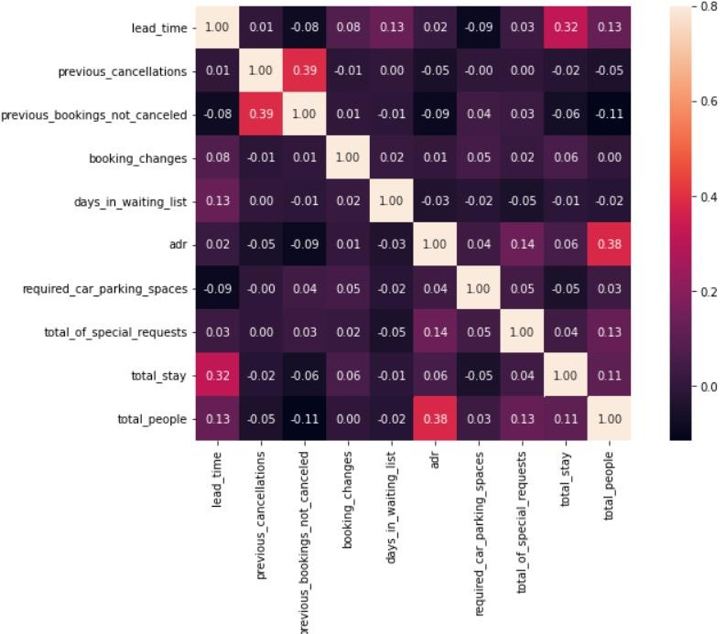
Correlation Heatmap
Total stay length and lead time are slightly correlated. This may means that for longer hotel stays, people generally plan little before the actual arrival.
adr is slightly correlated with total_people, which makes sense as more no. of people means more service to deliver, therefore more adr.

Slide 8
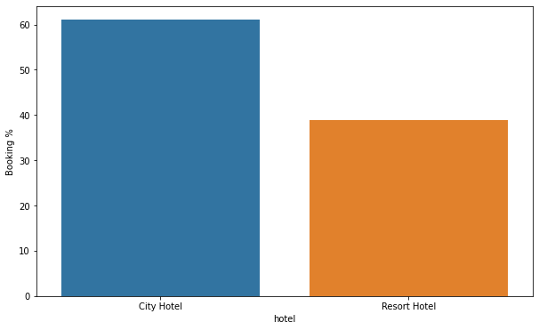
1) Which type of hotel is mostly prefered by the guests?
Analysis
In this we found that city hotel is preferred more as compared to resort hotel
As we can see around 50% more are come to city hotel as compared to resort hotel

Slide 9
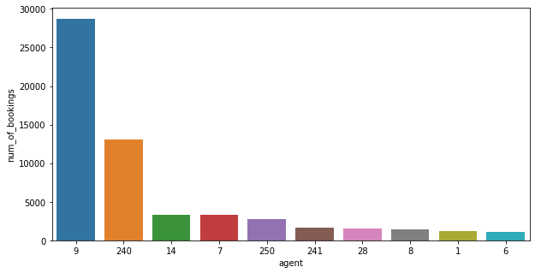
2.) Which agent made the most bookings?
ANALYSIS
There are about 500 agent through which booking is done out of which these are top 10.
In this analysis, we have considered agent index as agent and we can see clearly agent 9 did the maximum bookings.
Agent 240 did around 13000 booking but we can see around 70% booking did by both agent 9 and 240.

Slide 10
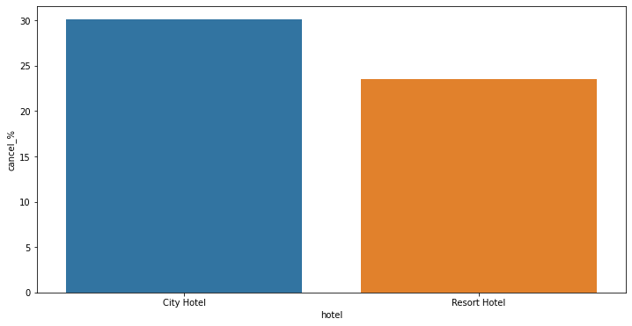
3)What is the percentage of cancellation?
ANALYSIS
This is also one of the most important aspect for improvisation.
As we can see, 30% of booking cancelled in city hotel and around 23 % in resort hotel.
This should be minimised for any business to grow.

Slide 11
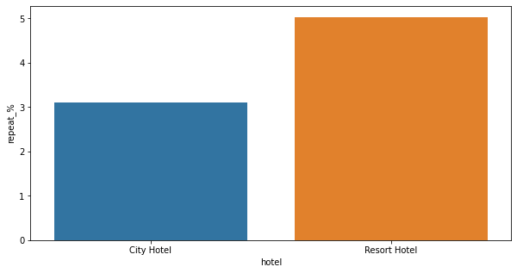
4.) What is the percentage of repeated guests?
ANALYSIS
This help us to create the goodwill in the market.
We can see that city hotel have only 3% of repeated guest whereas in resort hotel 5% of repeated guest is there.
So, we can see clearly that resort hotel is preferred more by the one’s who stay earlier.

Slide 12
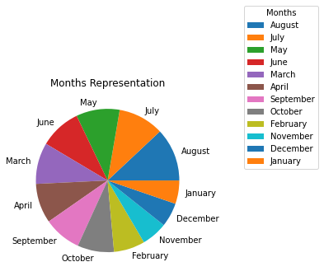
1.) What are the arrival months in city hotel?
This pie chart shows in which month the guest come more.
From the analysis we can see the peak season is July and August.
In this, we can see the customer is preferred more to stay in summer as compared to winter.

Slide 13
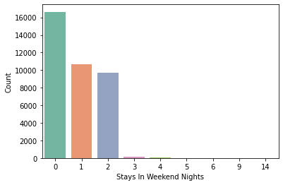
2.)What is the number of weekend nights that the customer has stayed or booked in the city hotel?
ANALYSIS
In this, we can see maximum customer prefer to stay weekend this show that more than 50 % customer prefer to stay maximum 2 weekend nights.

Slide 14
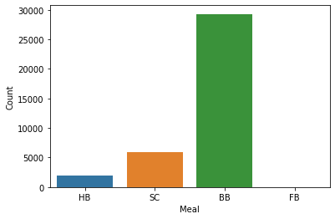
3.) Which type of meal is preferred in City Hotel?
In this analysis, we can understand customer prefer more to have only breakfast and room as compared to breakfast dinner included.
It shows customer prefer to eat outside as they went to sight-seeing.

Slide 15
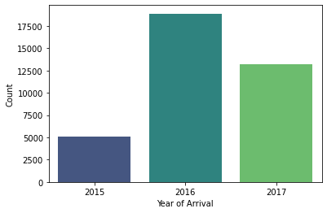
4.) In which year more people arrived in City Hotel?
In this, we have compared the year of data in which year maximum customer comes.
In 2016, guest come more as compared to other years.
In 2015, people come very less as compared to other years.

Slide 16
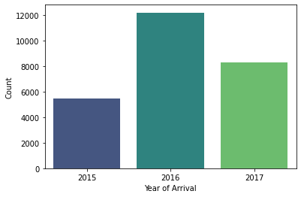
1.) In which year more number of people arrived in Resort Hotel?
In this hotel also, we can see the same pattern followed by the customer. In 2016, it is maximum and minimum in 2015.
In 2017, people again come less.

Slide 17
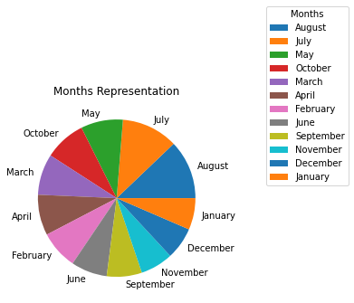
2.) What are the arrival months in Resort Hotel?
In this analysis, we can see that July and august is the most preferred to visit in resort hotel.
Although, summer season is preferred by customer but in winter approaching month October, customer again come more so this shows that resort hotel prefers all seasons.

Slide 18
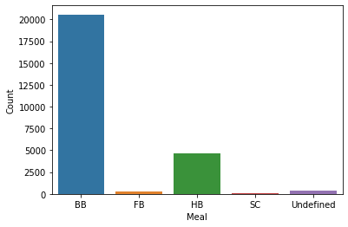
3.) Which type of breakfast is preferred in Resort Hotel?
In this analysis, again we see the same pattern.
Customer prefer to have only breakfast with room as compared to have full meal with both breakfast and dinner.

Slide 19
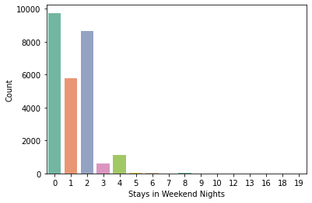
4.) What is the number of weekend nights that the customer has stayed or booked the Resort Hotel?
As compared to previous, in resort hotels customers tend to stay more as compared to other hotels.
In this, Customers have increased their stay up to 4 days significantly whereas it is not the case in city hotels.

Slide 20
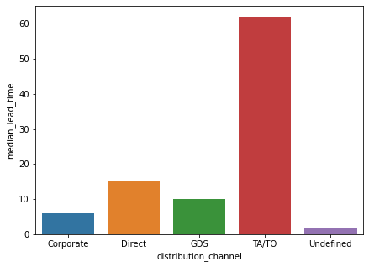
1.) Which channel is most often used to book hotels early?
We can see clearly, TA/TO channel is the maximum revenue generation source. it compromises almost 60% median lead time.
After then, direct distribution have highest but it is almost equal to Corporate and Gds.

Slide 21
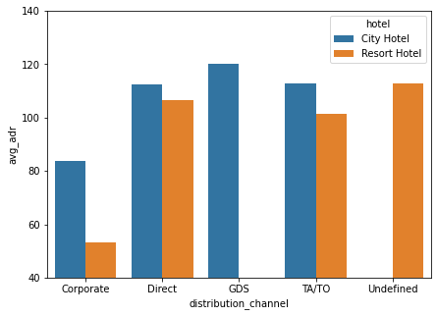
2.) Which distribution channel generates more revenue for hotels?
In this, we have compared the hotel wise analysis.
The GDS channel generates deals that bring more revenue to the hotels in the city, unlike most reservations made through TA/TO. City Hotel can work to increase reach in GDS channels to get more deals that generate higher revenue.
Resort hotel has more listings that generate revenue from direct channels and TA/TO. The resort hotel needs to increase reach in the GDS channel to increase sales.

Slide 22
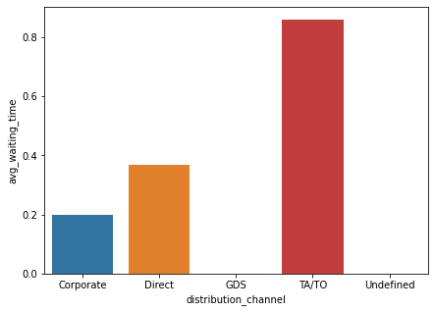
3.) Which channel has a longer average turnaround time?
If you book through TA/TO, you may have to wait a little longer to confirm your room reservation.
Whereas, in case of Gds and undefined have zero adr waiting time.
Direct channel also have high adr so there is scope to improve this and it could bring more new customer.

Slide 23
CONCLUSION
Around 60% bookings are for City hotel and 40% bookings are for Resort hotel, therefore City Hotel is busier
than Resort hotel. Also the overall adr of City hotel is slightly higher than Resort hotel.
Mostly guests stay for less than 5 days in hotel and for longer stays Resort hotel is preferred.
Both hotels have significantly higher booking cancellation rates and very few guests less than 3 % return for another booking in City hotel. 5% guests return for stay in Resort hotel.
Guests use different channels for making bookings out of which most preferred way is TA/TO.
Almost 30% of bookings via TA/TO are cancelled.
Not getting same room as reserved, longer lead time and waiting time do not affect cancellation of bookings.
Although different room allotment do lowers the adr.
July- August are the most busier and profitable months for both of hotels.
Within a month, adr gradually increases as month ends, with small sudden rise on weekends.
More number of people in guests results in more number of special requests.
Bookings made via complementary market segment and adults have on average high no. of special request.

